Slide 1

CAMERON SCHOOL OF BUSINESS STRATEGIC PROBLEM
Harold Omporo

Slide 2
AGENDA
THE PROBLEM
FISHBONE DIAGRAM
SWOT ANALYSIS
INTERNATIONAL ENROLLMENT
COLOMBIA - RECOMMENDATION
VENEZUELA - RECOMMENDATION
CURRENT STRATEGY ANALYSIS
RECOMMENDATIONS
ACTION ITEMS
NEW VISION STRATEGY

Slide 3

THE PROBLEM
“DECLINE OF ENROLLMENT IN THE MBA PROGRAM OF UNIVERSITY OF ST. THOMAS “

Slide 4
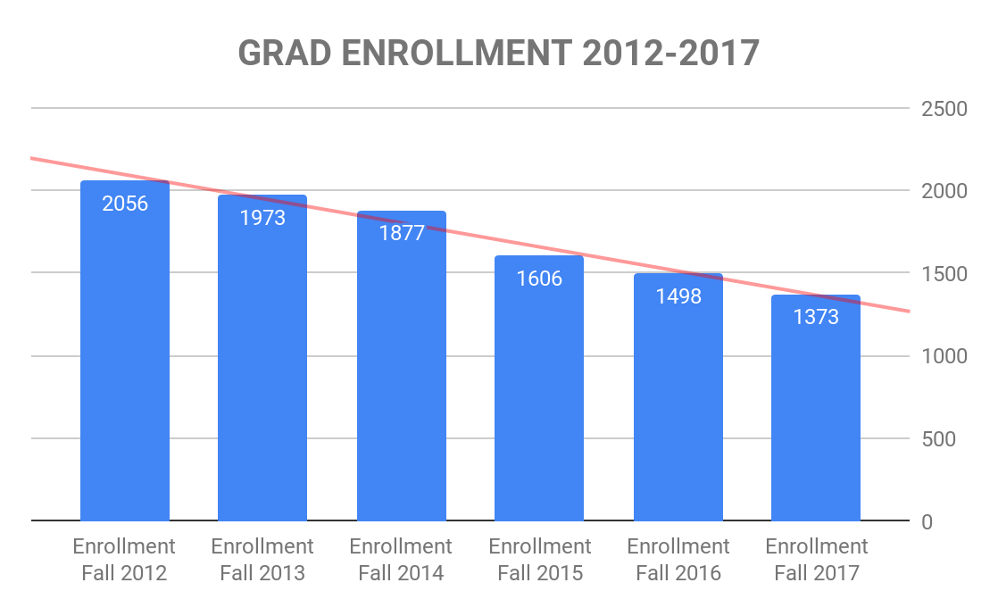
ENROLLMENT PER YEAR

Slide 5
FISHBONE DIAGRAM

Slide 6
PROBLEM & CAUSES
Problem | Causes | Sub-Causes
Socio Cultural
Economy
Political
Catholic Scandals
Exchange Rate
Immigration
MBA Decline of Enrollment
Scholarships
Student Activities
Social Media
Financial Aid
Campus Life
Branding

Slide 7
SWOT ANALYSIS

Slide 8
SWOT ANALYSIS
The Only Catholic University in Houston
Small Classrooms
Centrally located
Diversified Student Body
Grad Schedule-Flexibility
Subject Expert Professors
AACSB Accreditation
Flat Rate Tuition
Dual Degree Programs
Branding (Inside Campus, Alumni)
Alumni UST Motivation
Social media Presence
Internet Searches UST
Social & Networking
Job Placement Support
No Local Company Alliances
Parking
Scholarships
STRENGTHS
WEAKNESSES
S W O T
Catholic Youth groups
Local High Schools
Emerging Economies
Local International Alumni Chapters
Online Programs-Certifications
Online Classes
THREATS
OPPORTUNITIES
Catholic Church Scandals
VISA & Immigration Policies
Bad Economies and/or Political Unrest
Competitors Full Online Programs

Slide 9
INTERNATIONAL ENROLLMENT

Slide 10

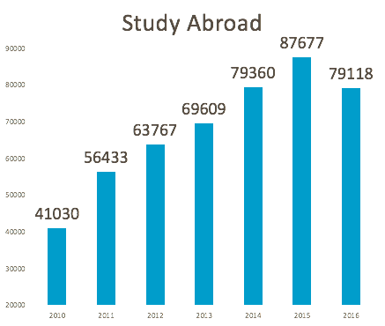
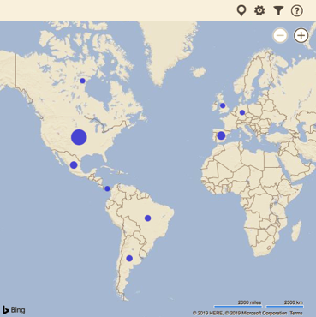
Students Annually Migration
35%

Slide 11
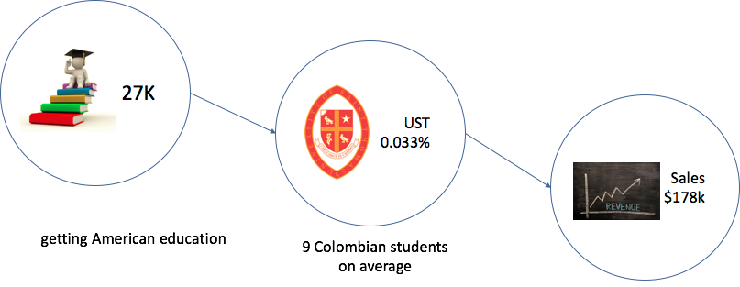
Current Strategy Results

Slide 12
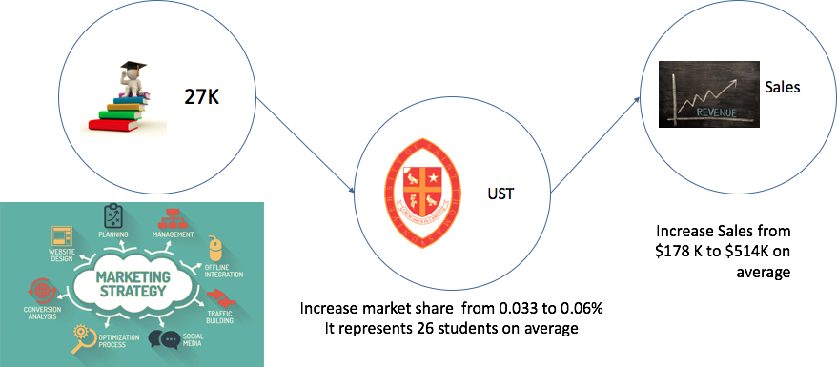
Recommendation

Slide 13
VENEZUELA

Slide 14





Factors Driving Low Venezuelan Students Enrollment
● Education is free in all Public Universities
Eliminated foreign currency quota for new students (March 2016)
Closure of the US embassy in Venezuela
Emigration Agreements
“On March 11, 2019, the U.S. Department of State announced the temporary suspension of operations of the U.S. Embassy in Caracas and the withdrawal of diplomatic personnel from Venezuela. The U.S. Embassy in Caracas is not providing any consular services. U.S. citizens residing or traveling in Venezuela should depart Venezuela. Commercial flights remain available.” (Source: US Embassy in Venezuela Website)

Slide 15
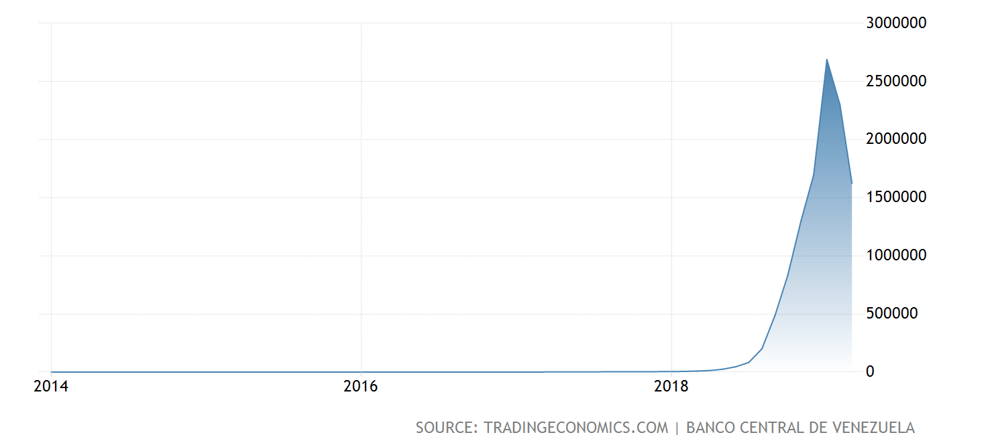
Factors Driving Low Venezuelan Students Enrollment
High Devaluation of Bolivares
The minimum wage per month is $4

Slide 16
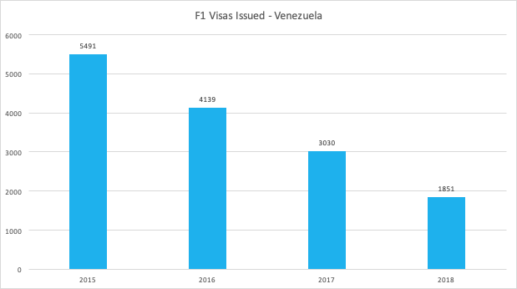
Pre-Approved Potential International Students
Source: Bureau of Consular Affairs Website

Slide 17
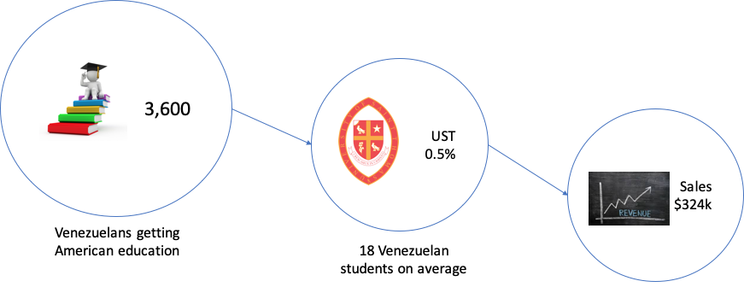
Current Strategy Results

Slide 18
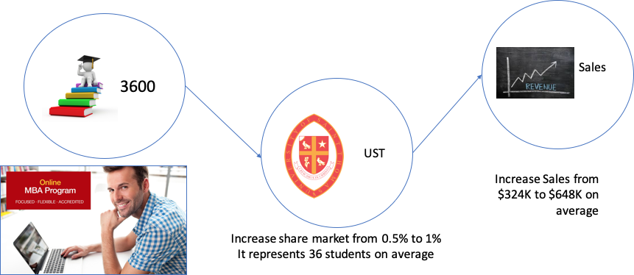
Recommendation

Slide 19
CURRENT STRATEGY ANALYSIS

Slide 20



CURRENT STRATEGY IMPLEMENTATION
100% EFFORTS ON INCREASING ENROLLMENT GRAD & UNDERGRAD
UNDERGRAD
MBA

Slide 21

SUGGESTED STRATEGY
50% EFFORTS ON INCREASING ENROLLMENT
50% EFFORT ON SUPPORTING EXIT
UNDERGRAD
MBA

Slide 22
RECOMMENDATIONS

Slide 23

ACTION ITEMS
IN CLASS NETWORKING (UNDERGRAD & GRAD LVL) STRONG JOB PLACEMENT (UNDERGRAD & GRAD LVL) SOCIAL MEDIA STRONG ALUMNI NETWORKING BRANDING FULL ONLINE PROGRAMS FOR INTL STUDENTS |  | INTERNATIONAL AMBASSADORS/MENTORS CATHOLIC YOUTH GROUP OUTREACH BRANDING CATHOLIC COMMUNITY MBA PROGRAM CHOICES BUSINESS CONNECTIONS LOCAL/INTL TARGETING INTL MARKET

Slide 24
NEW VISION STRATEGY
“ TO CREATE A STRONG LEGACY & LOYALTY BY REINFORCING A WELCOMING AND EFFECTIVE STUDENT NETWORK SUPPORT”

Slide 25
Q & A

Slide 26
REFERENCES
https://www.esc4.net/Assets/region4profile.pdf
http://www.govwiki.info/pdfs/Non-Profit/TX%20University%20Of%20St.%20Thomas%202016.pdf
2017-2018 FACT BOOK “UNIVERSITY OF ST. THOMAS HOUSTON”
2016-2017 FACT BOOK “UNIVERSITY OF ST. THOMAS HOUSTON”
2015-2016 FACT BOOK “UNIVERSITY OF ST. THOMAS HOUSTON”
Trading economics. www.tradingeconomics.com
US Department of State - Bureau of Consular Affairs. https://travel.state.gov/content/travel/en/us-visas/study/student-visa.html
US Embassy in Venezuela website. https://ve.usembassy.gov/u-s-citizen-services/
Eliminated foreign currency quota for new students (March 2016) http://inmueblescaracas.com.ve/cadivi/cadivi-dolar-estudiante.htm
https://www.elmundo.com/noticia/Viajar-para-estudiarla-eleccion-de-miles-de-colombianos/355683
https://www.dinero.com/economia/articulo/graduados-de-doctorado-en-colombia-y-el-resto-del-mundo/242911
https://www.urosario.edu.co/Revista-Nova-Et-Vetera/Vol-2-Ed-17/Omnia/Una-nacion-de-andariegos-Colombia-tras-40-anos-de/
https://www.archgh.org/

